Slide 1
FRF04 – MOCK_1 GROUP – 5
Teacher & Mentor : Nguyen Van Nghia – NghiaNV16
Member :
1 – Tran Trung Hieu
2 – Le Trung Kien
3 – Ngo Ngoc Quang
4 – Nguyen Van Tinh

Slide 2
READ FAT FILE
Overview
Programming Structure
Result

Slide 3

Overview
FAT FILE ?
DISK FOMAT ?
FOR WHAT ?
FAT 12/16/32

Slide 4

What is fat file ?
The FAT file system (File Allocation Table) is heavily based on the file map model in terms of its on-disk layout
This file system was used on all versions of MS-DOS and PC-DOS, and on early versions of Windows
It is a reasonably simple, reasonably robust file system.
Three basic variants of the FAT file system:
Floppy disks and small hard disks usually use the 12-bit version, which was superseded by the 16-bit version as hard disks became bigger. This in turn was superseded by the 32-bit version as disks became bigger still.

Slide 5

What is fat file ?
Any disk is made up of surfaces (one for each head), tracks and sectors. → we can consider a disk as a simple storage area made up just of a number of sectors (index start by 0).
All blocks are the same size, 512 bytes, on practically all FAT file systems.
Howewer, large disks can have too many blocks for comfort, so blocks are sometimes grouped together in pairs (or fours, or eights, etc...); each such grouping is called an allocation unit.
The FAT file system actually works in allocation units, not blocks

Slide 6
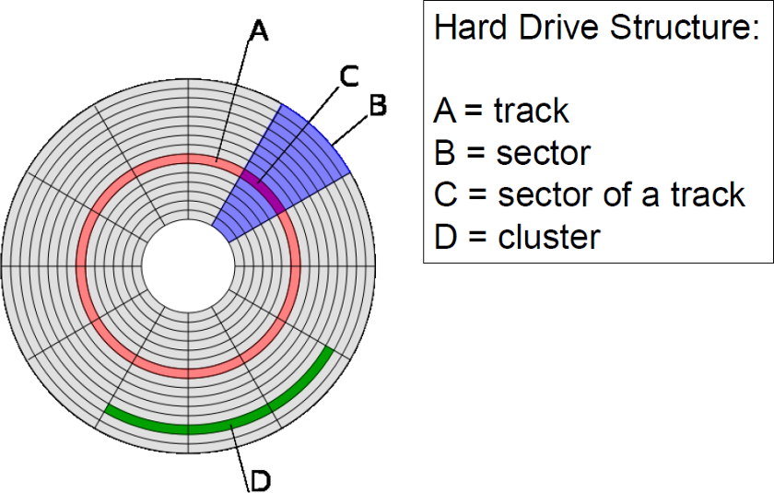
DISk fomat – Basic layout
FAT
Root Directory
Data
Boot Block

Slide 7
Disk fomat – boot block
The boot block occupies just the first block of the disk. It holds a special program (the bootstrap program) which is used for loading the operating system into memory.
Offset from start | Length | Description
0x00 | 3 bytes | Part of the bootstrap program
0x03 | 8 bytes | Optional manufacture description
0x0b | 2 bytes | Number of bytes per block ( almost always 512)
0x0d | 1 bytes | Number of block per allocation unit
0x0e | 2 bytes | Number of reserved block – the number of blocks on the disk that are not actually part of the file system.
0x10 | 1 bytes | Number of File Allocation Tables

Slide 8
Disk Format – Root Directory
The root directory contains an entry for each file whose name appears at the root of the file system. Other directories can appear within the root directory, they are called subdirectories
The format of all directories is the same. Each entry is 32 bytes (0x20) in size, so a single block can contain 16 of them
Offset | length | Description
0x00 | 8 bytes | Filename
0x08 | 3 bytes | Filename extension
0x0b | 1 bytes | File attributes
0x0c | 10 bytes | Reserved
0x16 | 2 bytes | Time created or last updated
0x18 | 2 bytes | Date created or last updated
0x1a | 2 bytes | Starting cluster number for file
0x1c | 4 bytes | File size in bytes

Slide 9
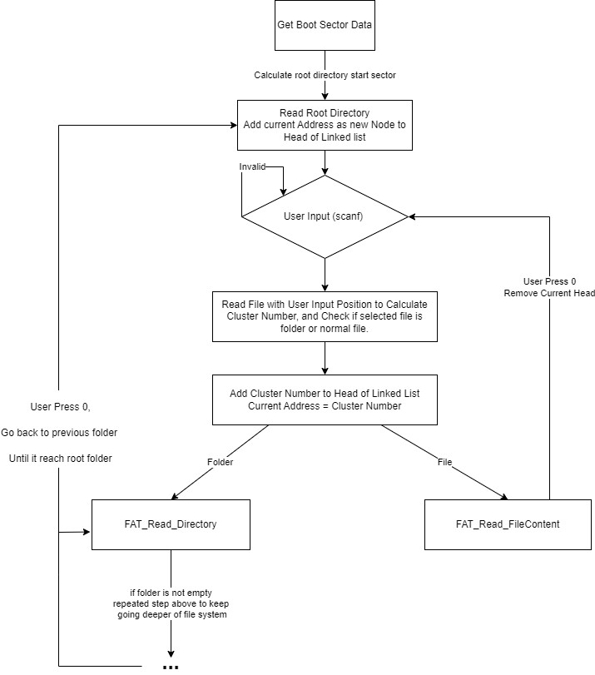
Programming Structure

Slide 10
The end

